Slide 1
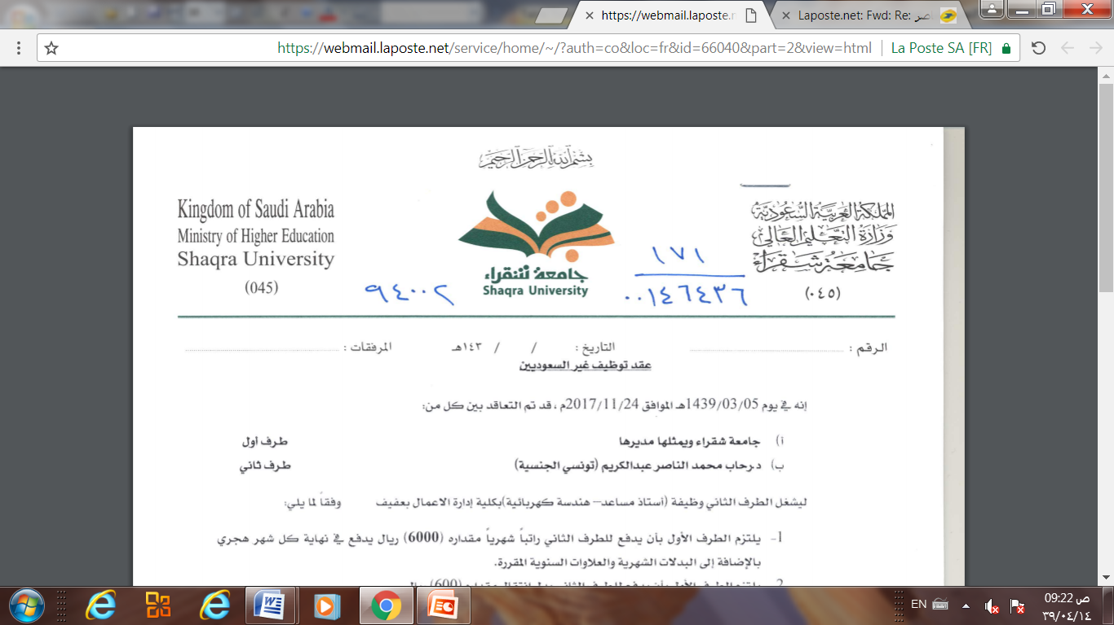
Database Management system
Lecture 8 (part1)
Object,Object-Relational,and XML: Concepts, Models, Languages,
and Standards
Dr. Rihab Mohamed Naceur ABDELKRIM
E-mail: rihab@su.edu.sa
2017 - 2018

Slide 2
Outline
Overview of Object Databases Concept
Object-Relational Features: Object Database Extensions to SQL
XML: Extensible Markup Language
Structured, Semi-structured, and Unstructured Data
XML Hierarchical (Tree) Data Model
XML Documents, DTD, and XML Schema
Storing and Extracting XML Documents from Databases and Relational Databases

Slide 3
1- Overview of Object Database Concepts
In this chapter, we discuss the features of object oriented data models and show how some of these features have been incorporated in relational database systems.
Object-oriented databases are now referred to as object databases (ODB) (previously called OODB).
The database systems are referred to as object data management systems (ODMS).

Slide 4
1- Overview of Object Database Concepts
the need for new data types for storing images, videos, or large textual items; longer-duration transactions; and the need to define non standard application-specific operations.
Object databases were proposed to meet some
of the needs of these more complex applications.
A key feature of object databases is the power
they give the designer to specify both the structure
of complex objects and the operations that can be applied to these objects.

Slide 5
1- Overview of Object Database Concepts
■ Object identity. Objects have unique identities that are independent of their attribute values and are generated by the ODMS.
■ Type constructors. Complex object structures can be constructed by applying in a nested manner a set of basic constructors, such as tuple, set, list, array, and bag.
■ Encapsulation of operations. Both the object structure and the operations that can be applied to individual objects are included in the type definitions.

Slide 6
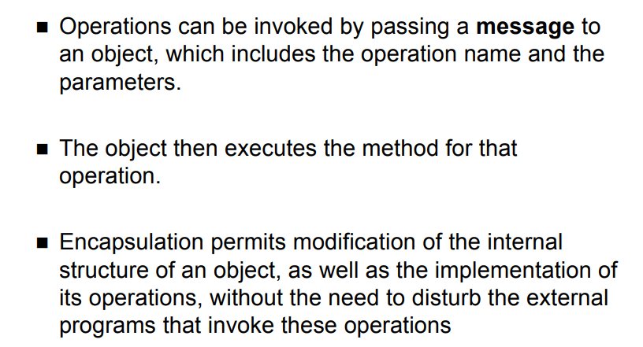
1- Overview of Object Database Concepts
Programming language compatibility. Both persistent and transient objects are handled seamlessly. Objects are made persistent by being reachable from a persistent collection (extent) or by explicit naming.
An object B is said to be reachable from an object A if a sequence of references in the database lead from object A to object B.

Slide 7
1- Overview of Object Database Concepts
■ Type hierarchies and inheritance. Object types can be specified by using a type hierarchy, which allows the inheritance of both attributes and methods (operations) of previously defined types. Multiple inheritance is allowed in some models.
■ Extents. All persistent objects of a particular type can be stored in an extent. Extents corresponding to a type hierarchy have set/subset constraints enforced on their collections of persistent objects.
Some OO database systems have a predefined system type (called the ROOT class or the OBJECT class) whose extent contains all the objects in the system.

Slide 8
2- Object-Relational Features:
Object Database Extensions to SQL
The following are some of the object database features that have been included in SQL:
■ Some type constructors have been added to specify complex objects.
These include the row type, which corresponds to the tuple (or struct) constructor.
An array type for specifying collections is also provided.
■ A mechanism for specifying object identity through the use of reference type is included.

Slide 9
2- Object-Relational Features:
Object Database Extensions to SQL
■ Encapsulation of operations is provided through the mechanism of user defined types (UDTs) that may include operations as part of their declaration.
■ Inheritance mechanisms are provided using the keyword UNDER.

Slide 10
2- Object-Relational Features:
Object Database Extensions to SQL
User-Defined Types and Complex Structures for Objects
To allow the creation of complex-structured objects, and to separate the declaration of a type from the creation of a table, SQL now provides user-defined types (UDTs).
A UDT may be specified in its simplest form using the following syntax:
Figure 11.4 illustrates some of the object concepts in SQL.

Slide 11
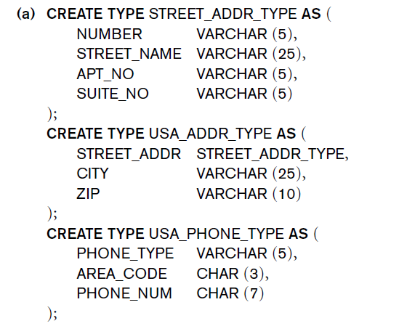
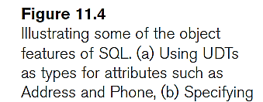
User-Defined Types and Complex Structures for Objects
Example

Slide 12
2- Object-Relational Features:
Object Database Extensions to SQL
2. Object Identifiers Using Reference Types
Unique system-generated object identifiers can be created via the reference type in the latest version of SQL. For example, in Figure 11.4(b), the phrase:
REF IS SYSTEM GENERATED

Slide 13
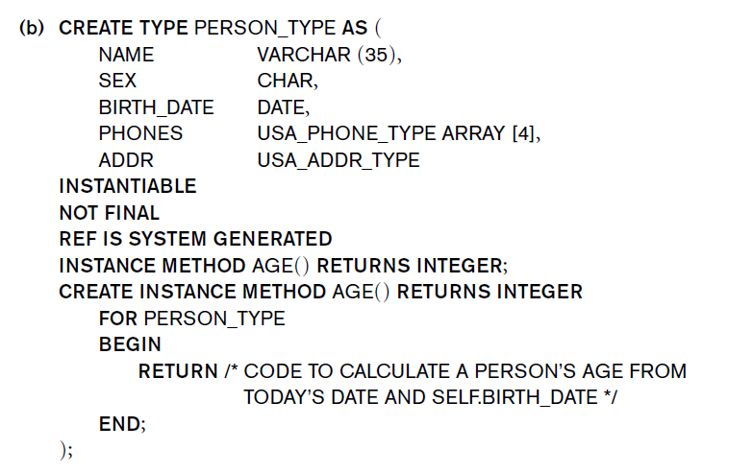
2. Object Identifiers Using Reference Types
Example
(b) Specifying
UDT for PERSON_TYPE
indicates that whenever a new PERSON_TYPE object is created, the system will assign it a unique system-generated identifier.

Slide 14
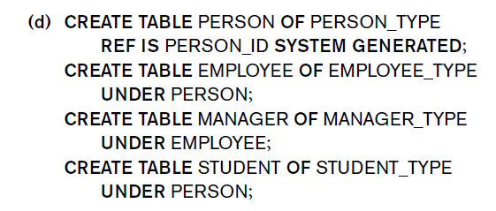
2- Object-Relational Features:
Object Database Extensions to SQL
3. Creating Tables Based on the UDTs
This is illustrated in Figure11.4(d), where we create a table PERSON based on the PERSON_TYPE UDT.
Creating tables based
on some of the UDTs,
and illustrating table
Inheritance.

Slide 15
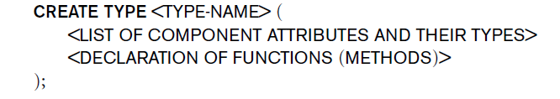
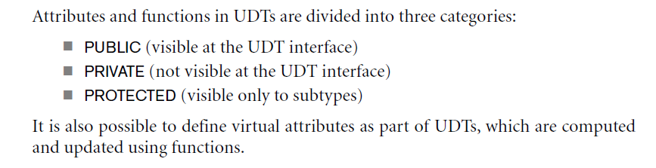
2- Object-Relational Features:
Object Database Extensions to SQL
4. Encapsulation of Operations
In SQL, a user-defined type can have its own behavioral specification by specifying methods (or operations) in addition to the attributes.
The general form of a UDT specification with methods is as follows:

Slide 16
2- Object-Relational Features:
Object Database Extensions to SQL
4. Encapsulation of Operations
For example, in Figure 11.4(b)

Slide 17
2- Object-Relational Features:
Object Database Extensions to SQL
5. Specifying Inheritance
All attributes are inherited.
The order of supertypes in the UNDER clause determines the inheritance hierarchy.
Consider the following examples to illustrate type inheritance, which are illustrated in Figure 11.4(c).
Suppose that we want to create two subtypes of PERSON_TYPE: EMPLOYEE_TYPE.
In addition, we also create a subtype MANAGER_TYPE that inherits all the attributes (and methods) of EMPLOYEE_TYPE but has an additional attribute DEPT_MANAGED.

Slide 18
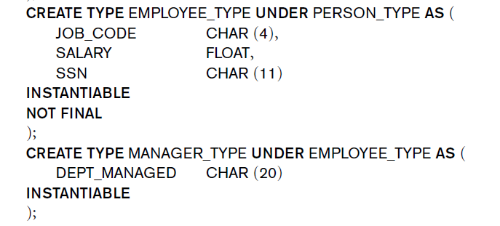
2- Object-Relational Features:
Object Database Extensions to SQL
5. Specifying Inheritance
For example

Slide 19
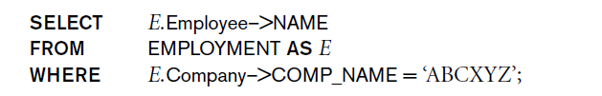
2- Object-Relational Features:
Object Database Extensions to SQL
6. Specifying Relationships via Reference
SQL uses a dot notation to build path expressions that refer to the component attributes of tuples and row types.
However, for an attribute whose type is REF,
the dereferencing symbol –> is used.
For example, the query below retrieves employees working in the company named ‘ABCXYZ’ by querying the EMPLOYMENT table:

